Slide 1
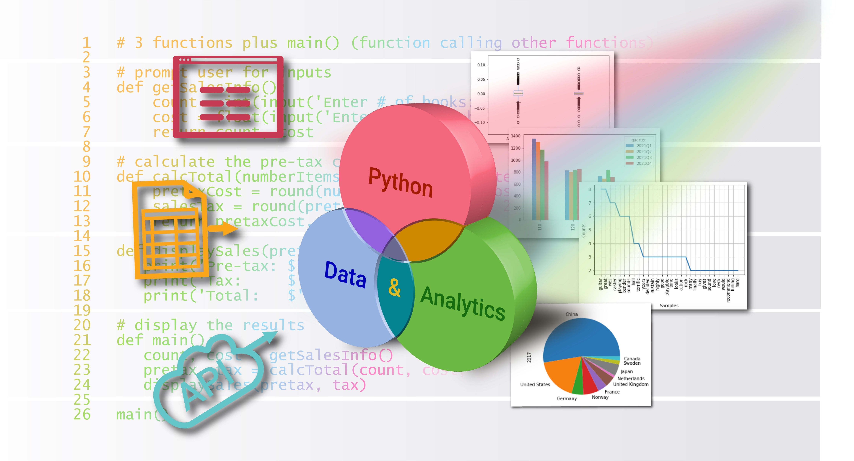
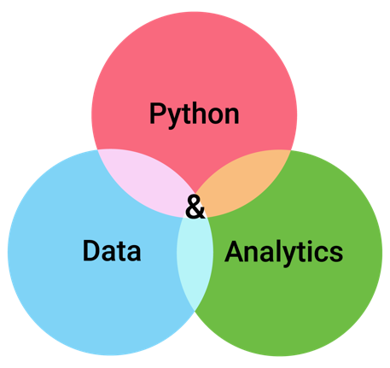
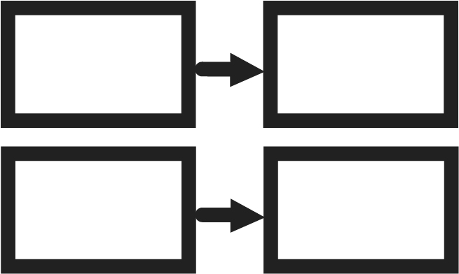

Dictionaries and Sets
Chapter 9
Python for Data & Analytics
A Business-Oriented Approach
© 2023 Rose River Software, LLC

Slide 2
Topics
About dictionaries
Creating dictionaries
Find data in a dictionary
Using for to visit dictionary items
Storing data fields in dictionaries
Maintaining data in dictionaries
Sets
About the hashable type

Slide 3
Topics
About dictionaries
Creating dictionaries
Find data in a dictionary
Using for to visit dictionary items
Storing data fields in dictionaries
Maintaining data in dictionaries
Sets
About the hashable type

Slide 4
About dictionaries
Collections of data are an important aspect of programs
Lists are one way that data can be collected
Dictionaries are another type of data collection
In contrast with lists that sequentially number each item (the index), dictionaries allow you to name each item
We'll use strings to name each dictionary item; other Python types can be used
A dictionary stores a collection of keys; each key is points to a value
Each key in a dictionary needs to be unique

Slide 5
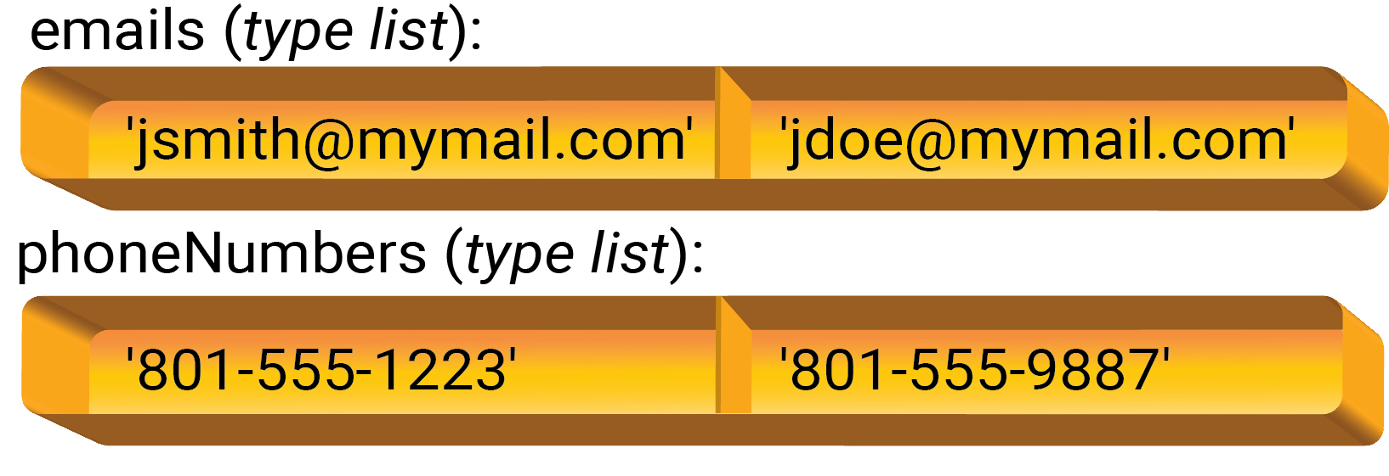
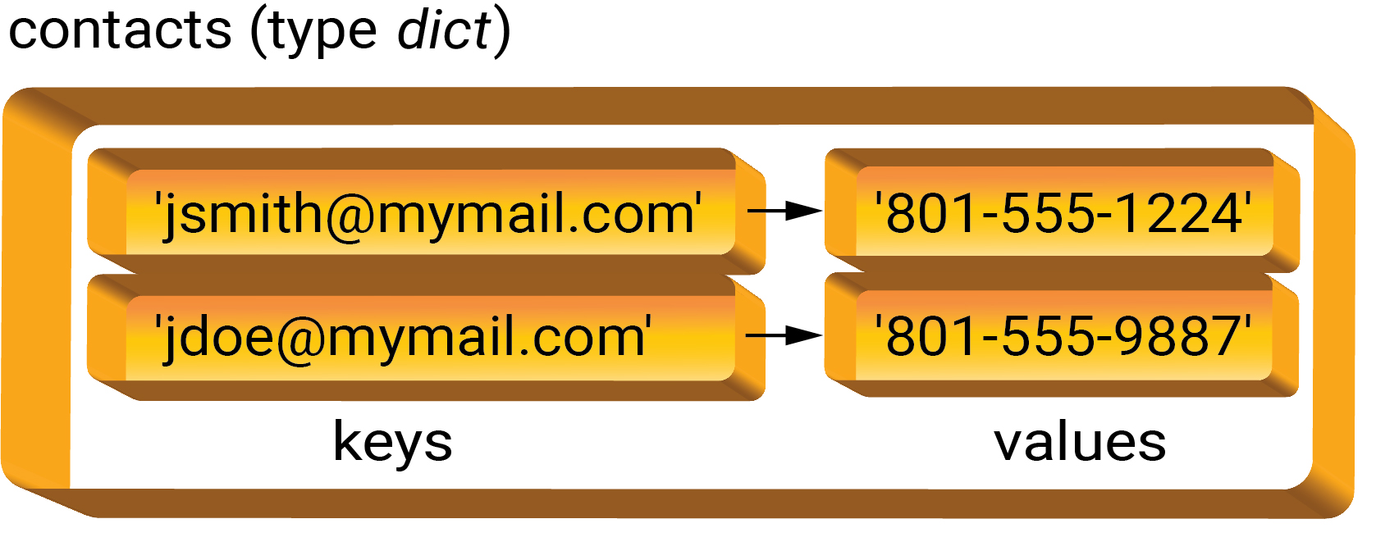
About dictionaries
Example: keeping track of contacts (email addresses, phone numbers)
Could use 2 parallel lists
Alterative arrangement: 1 dictionary

Slide 6
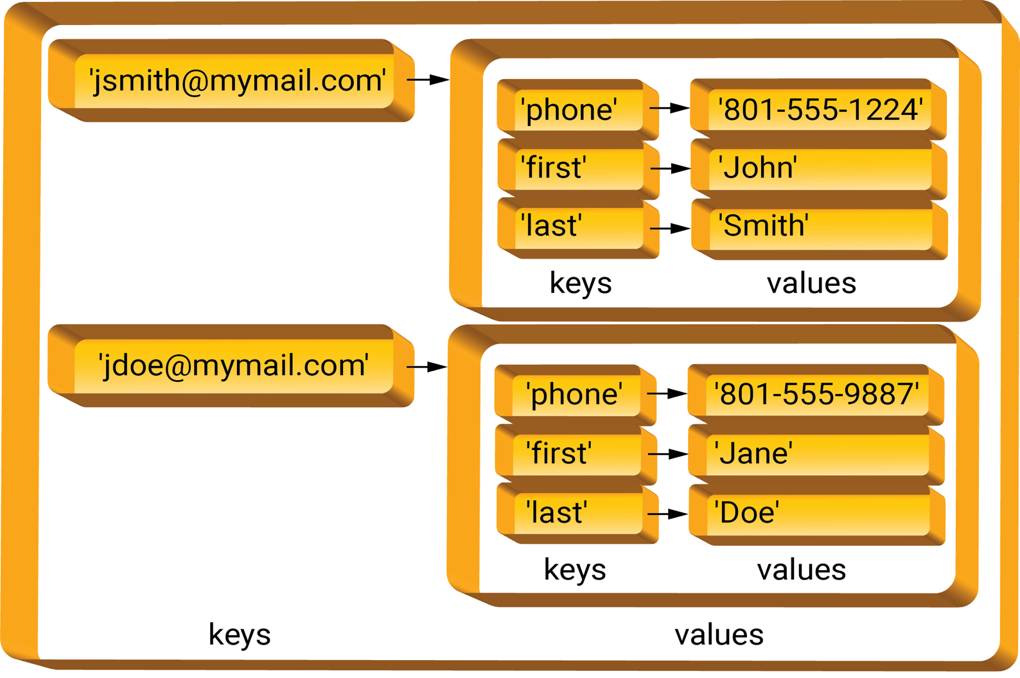
About dictionaries
Benefits of dictionary arrangement for contacts data:
Lookup is faster (dictionaries are structured so all keys don't need to be searched)
The dictionary arrangement is more tightly connected (one variable)
Related, maintaining the dictionary is less error-prone than maintaining parallel lists
Capturing more information is possible with a dictionary of dictionaries

Slide 7
About dictionaries
Spreadsheet Compare/Contrast: Labelling and Naming Cells
In spreadsheets, you can use text cells to label values in adjacent cells; you can also name a cell
These layouts are roughly similar to the idea of a dictionary in Python
However, Python dictionary value types are not limited to simple types such as text, numbers, and dates
This expressiveness of dictionaries – that values can be lists, dictionaries, or any other Python type, allows Python to model complex data layouts in ways that can be hard to do in spreadsheets

Slide 8
Topics
About dictionaries
Creating dictionaries
Find data in a dictionary
Using for to visit dictionary items
Storing data fields in dictionaries
Maintaining data in dictionaries
Sets
About the hashable type

Slide 9

Creating dictionaries
Like lists, dictionaries can either
have their items indicated when created, or
Most of our examples will use this approach
start empty and have contents subsequently added
In practice this is common
To define a dictionary and add items in one statement, use { }
contacts = {'jsmith@mymail.com': '801-555-1223',
'jdoe@mymail.com': '801-555-9887'} In above, key and its related value are separated by a colon

Slide 10
Creating dictionaries
Alternatively, an empty dictionary can be created, e.g.,
contacts = { }
And then key / value pairs can be added subsequently with syntax
dictionaryVariable[key] = value
For example,
contacts['jsmith@mymail.com'] = '801-555-1223'
In the above, the key 'jsmith@mymail.com' and its associated value '801-555-1223' are added to the dictionary named contacts

Slide 11

Creating dictionaries
An empty dictionary is created and assigned to variable contacts
Program 9-1
# build a contact dictionary dynamically from user input
contacts = {} # create an empty dictionary
print('Enter email and phone # at > prompt (<return> when done)')
entry = input('> ')
while entry != '':
email, phone = entry.split()
contacts[email] = phone # add entry to dictionary
print(contacts)
entry = input('> ')
Enter email and phone # at > prompt (<return> when done)
> jsmith@mymail.com 801-555-1223
{'jsmith@mymail.com': '801-555-1223'}
> jdoe@mymail.com 801-555-9887
{'jsmith@mymail.com': '801-555-1223', 'jdoe@mymail.com': '801-555-9887'}
>
a key and its value are added to (or updated in) the dictionary

Slide 12
Topics
About dictionaries
Creating dictionaries
Find data in a dictionary
Using for to visit dictionary items
Storing data fields in dictionaries
Maintaining data in dictionaries
Sets
About the hashable type

Slide 13
Find data in a dictionary
Once a dictionary has been populated, look up data using key as:
value = dictionaryVariable[key]
Note the syntax is similar to accessing a list's item by its index
List item access is always by an integer index
Dictionary value access is by key value type
Keys have been string in our examples; key can be other Python types (e.g., integer)

Slide 14
Find data in a dictionary
Program 9-2
# Dictionary example to lookup phone (value) from email (key)
# create the dictionary
contacts = {'jsmith@mymail.com': '801-555-1223',
'jdoe@mymail.com': '801-555-9887'}
print('Enter an email address to lookup phone (or <return> when done)')
email = input('> ')
while email != '':
phone = contacts[email] # use email as key to lookup phone
print(phone)
email = input('> ')
Look up value with key
Enter an email address to lookup phone (or <return> when done)
> jdoe@mymail.com
801-555-9887
> jsmith@mymail.com
801-555-1223
>

Slide 15
Find data in a dictionary
For the value access statement:
value = dictionaryVariable[key]
If the key is not stored in the dictionary, then a KeyError will result
To avoid this error, first check for the key using an in statement
General forms:
<keyValue> in <dictionaryVariable>
<keyValue> not in <dictionaryVariable>
For example,
if <keyValue> not in <dictionaryVariable>:
# handle not found

Slide 16
Find data in a dictionary
Program 9-3
# Dictionary example to lookup phone from email
contacts = {'jsmith@mymail.com': '801-555-1223',
'jdoe@mymail.com': '810-555-9887'}
print('Enter an email address to lookup phone, or <return> when done')
email = input('> ')
while email != '':
if email in contacts: # check if the email is a key in dictionary
phone = contacts[email] # if so, look up value from key
print(phone)
else:
print('** not found **')
email = input('> ')
Check if dictionary contains particular key
Enter an email address to lookup phone, or <return> when done
> jsmith@mymail.com
801-555-1223
> jjones@mymail.com
** not found **
>

Slide 17
Topics
About dictionaries
Creating dictionaries
Find data in a dictionary
Using for to visit dictionary items
Storing data fields in dictionaries
Maintaining data in dictionaries
Sets
About the hashable type

Slide 18
Using for to visit dictionary items
Since a dictionary has key/value pairs, there are a few ways to visit items in the dictionary using for
for key in dict.keys(): | Iterate through the keys of the dictionary
for value in dict.values(): | Iterate through the values of the dictionary
for key, value in dict.items(): | Iterate through the key/value pairs of the dictionary

Slide 19
Using for to visit dictionary items
Program 9-4
# Dictionary example to display all keys and values
contacts = {'jsmith@mymail.com': '801-555-1223',
'jdoe12@mymail.com': '801-555-9887'}
for email, phone in contacts.items():
print(email, phone)
print(len(contacts), 'contacts in dictionary')
for with items() to iterate over keys and their values
len() returns the number of keys in a dictionary
jsmith@mymail.com 801-555-1223
jdoe12@mymail.com 801-555-9887
2 contacts in dictionary

Slide 20
Topics
About dictionaries
Creating dictionaries
Find data in a dictionary
Using for to visit dictionary items
Storing data fields in dictionaries
Maintaining data in dictionaries
Sets
About the hashable type

Slide 21
Storing data fields in dictionaries
Dictionaries can be used to collect a set of fields
field names are the keys of the data
field values are the values associated with the keys
This can be arranged as a dictionary of dictionaries

Slide 22
Storing data fields in dictionaries
Program 9-5
# contacts as a dictionary of dictionary records
# establish a dictionary of dictionaries
contacts = {
'jsmith@mymail.com':
{'phone': '801-555-1223', 'last':'Smith', 'first':'John'},
'jdoe12@mymail.com':
{'phone': '801-555-1223', 'last':'Doe', 'first':'Jane'},
}
# display the data as a table
for email, data in contacts.items():
print(email, data['first'], data['last'], sep='\t')
Data is stored as a dictionary of dictionaries
Values are sub-dictionaries
Keys are field names
jsmith@mymail.com John Smith
jdoe12@mymail.com Jane Doe

Slide 23
Topics
About dictionaries
Creating dictionaries
Find data in a dictionary
Using for to visit dictionary items
Storing data fields in dictionaries
Maintaining data in dictionaries
Sets
About the hashable type

Slide 24
Maintaining data in dictionaries
Adding a key and value
dictionaryVariable[key] = value
Above updates a value if the key is already in the dictionary
Delete a key and its value:
del dictionaryVariable[key]
Combining dictionaries:
dict1.update(dict2)
if key is in dict1 and dict2, the resulting value will be from dict2

Slide 25
Maintaining data in dictionaries
Program 9-6
# contacts as a dictionary, with maintenance
contacts = {
'jsmith@mymail.com': '801-555-1223',
'jdoe12@mymail.com': '801-555-9887'
}
def add(contacts):
id = input('email of contact to add/update: ')
phone = input('phone of contact to add/update: ')
contacts[id] = phone
def delete(contacts):
key = input('email of contact to delete: ')
if key in contacts: del contacts[key]
else: print('Error, email not found in contacts')
def display(contacts):
for email, phone in contacts.items():
print(email, phone, sep='\t')
def menu():
print('+ add - delete * display / quit ? help')
menu()
command = input('action: ')
while command not in ('', '/'):
if command == '+': add(contacts)
elif command == '-': delete(contacts)
elif command == '*': display(contacts)
elif command == '?': menu()
else: print('Unknown command')
command = input('action: ')
+ add - delete * display / quit ? help
action: +
email of contact to add/update: djones@mymail.com
phone of contact to add/update: 801-555-5687
action: -
email of contact to delete: jsmith@mymail.com
action: *
jdoe12@mymail.com 801-555-9887
djones@mymail.com 801-555-5687
action: /

Slide 26
Topics
About dictionaries
Creating dictionaries
Find data in a dictionary
Using for to visit dictionary items
Storing data fields in dictionaries
Maintaining data in dictionaries
Sets
About the hashable type

Slide 27
Sets
A Python set is a collection whose items are distinct
like a dictionary with keys but no values
unlike a list, a set is not ordered (Python decides the order)
Can create a set of items with curly braces, e.g.,
colors = {'red', 'green', blue'}
Can create an empty set with:
colors = set()
Add an item to a set with add() method, e.g., colors.add('red')
To remove an item, use remove() method, e.g., colors.remove('red')
The for statement can be used to access each item in a set

Slide 28
Sets
Concise operations for two sets
operation | syntax | description
union | a | b | Set of items in a or b
intersection | a & b | Set of items in both a and b
difference | a - b | Set of items in a that are not in b
symmetric difference | a.symmetric_difference(b) | Set of items in a or b but not in both
>>> set1 = {'green', 'blue', 'red'}
>>> set2 = {'green', 'blue', 'yellow'}
>>> set1 | set2
{'blue', 'red', 'yellow', 'green'}
>>> set1 & set2
{'blue', 'green'}

Slide 29
Sets
Create an empty set and assign to variable aset
Program 9-7
# build a contact set dynamically from user input
aset = set() # create an empty set
print('Enter email at > prompt (or <return> when done)')
entry = input('> ')
while entry != '':
if entry[0] == '-': # a leading - indicates remove
item = entry[1:].strip()
if item in aset:
aset.remove(item)
else:
print('** error, entry not found in set')
else:
aset.add(entry) # add entry to set (if not already in)
print(aset)
entry = input('> ')
Enter email at > prompt (<return> when done)
> jsmith@mymail.com
{'jsmith@mymail.com'}
> jdoe12@mymail.com
{'jsmith@mymail.com', 'jdoe12@mymail.com'}
> jsmith@mymail.com
{'jsmith@mymail.com', 'jdoe12@mymail.com'}
> -jdoe12@mymail.com
{'jsmith@mymail.com'}
>
Checking
with in
Remove item from set
add item to set

Slide 30
Topics
About dictionaries
Creating dictionaries
Find data in a dictionary
Using for to visit dictionary items
Storing data fields in dictionaries
Maintaining data in dictionaries
Sets
About the hashable type

Slide 31
About the hashable type
A Python dictionary's keys can be certain Python types
We've used strings in our examples (this is a common choice for keys)
Other types are possible (for example, int)
The type of a dictionary's key must be hashable
A hashable type is one that is:
Static
Comparable to another value
The items in a set need to be hashable

Slide 32
About the hashable type
You can check if a type is hashable interactively
Create a small dictionary or set
For example, a list is not hashable (its items can be changed, so it is not static)
Alternatively, a tuple is hashable (its items can't be changed)
>>> {['jsmith', 'mymail.com']}
Traceback (most recent cell last):
File <pyshell>", line 1, in <module>
TypeError: unhashable type: 'list'
>>> {('jsmith', 'mymail.com')}
{('jsmith', 'mymail.com')}

Slide 33
Topic Recap
About dictionaries
Creating dictionaries
Find data in a dictionary
Using for to visit dictionary items
Storing data fields in dictionaries
Maintaining data in dictionaries
Sets
About the hashable type

Slide 34
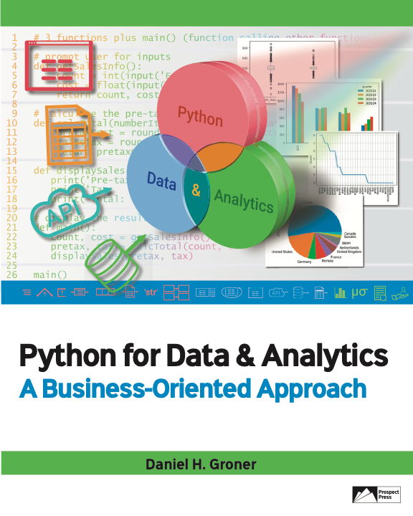
© 2023 Rose River Software, LLC
All rights reserved. This material may not be copied or distributed without permission from Prospect Press

